Slide 1
Digital Electronics and Systems

Slide 2
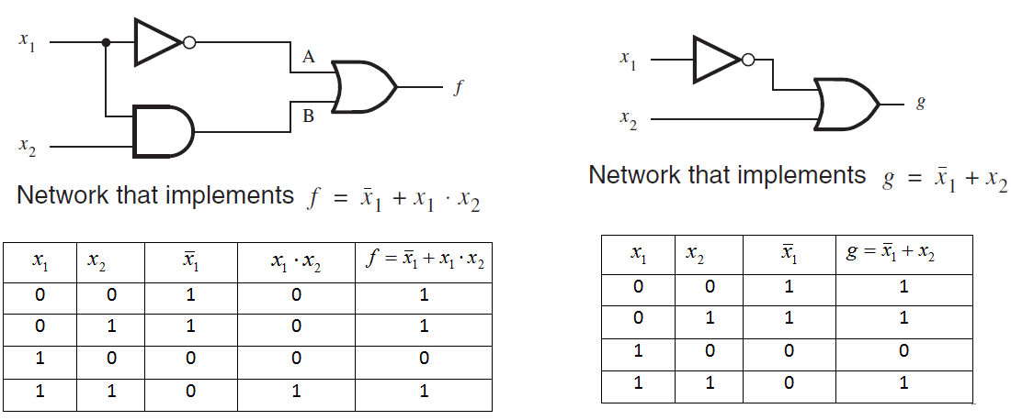
Boolean Algebra
It is a set of rules, used to simplify the given logic expression without changing it’s functionality.
Example:

Slide 3
Laws of Boolean Algebra
Commutative Law
Associative Law
Distributive Law

Slide 4
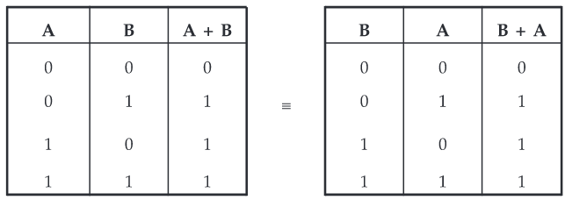
Commutative Laws
Law 1 : A+B = B+A

Slide 5
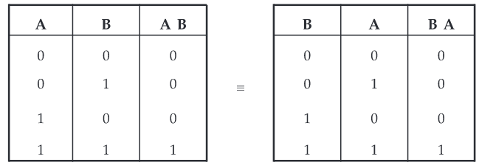
Law 2 : AB = BA
It is important to note that commutative law can be extended to any number of variables.
Example: A+B+C = B+A+C
ABCD = BACD

Slide 6
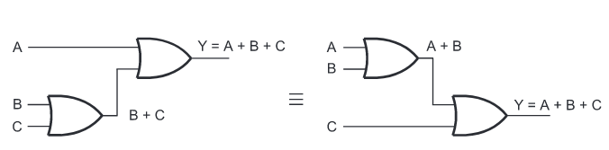
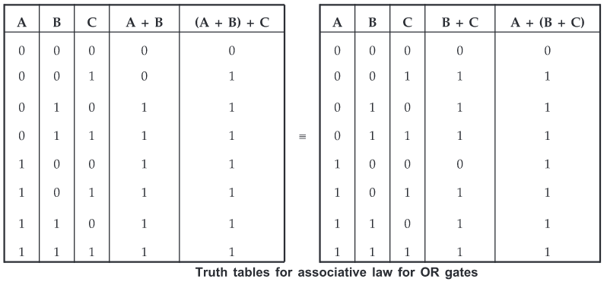
Associative Law
Law 1 : A+ (B+C) = (A+B)+C
Result is same regardless of the grouping of the variables.

Slide 7
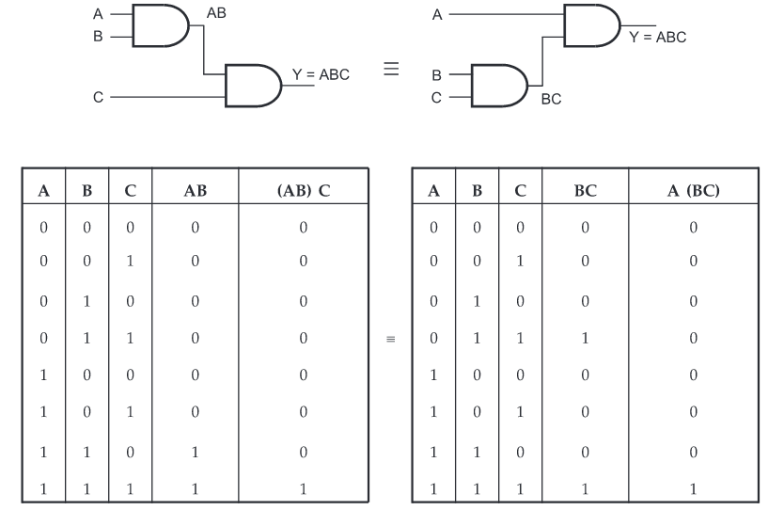
Law 2 : (AB) C = A (BC)

Slide 8
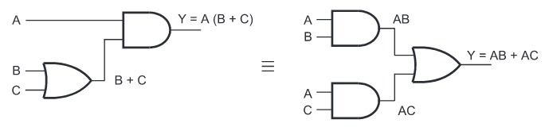
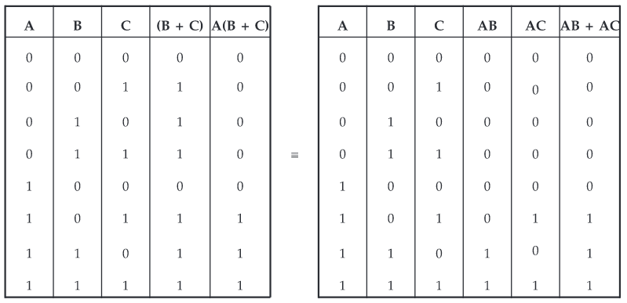
Distributive Law
Law : A (B+C) = AB + AC

Slide 9
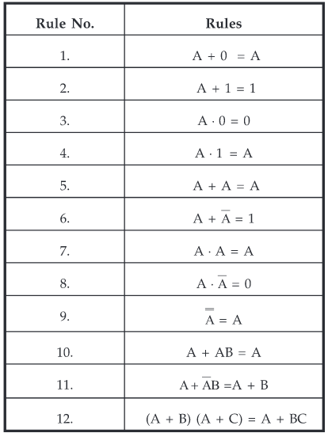
Rules in Boolean Algebra

Slide 10
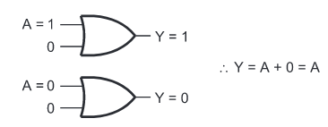
Illustration of Rule 1 Output, Y = A+0 = A

Slide 11
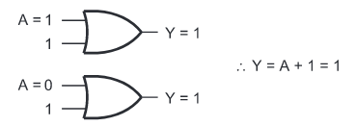
Illustration of Rule 2 Output, Y = A+1 = 1

Slide 12
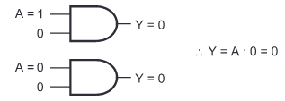
Illustration of Rule 3 Output, Y = A.0 = 0

Slide 13
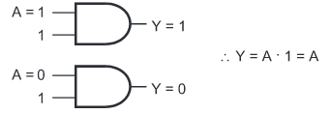
Illustration of Rule 4 Output, Y = A.1 = A

Slide 14
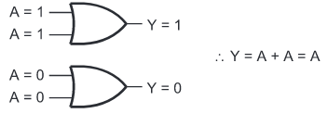
Illustration of Rule 5 Output, Y = A+A = A

Slide 15

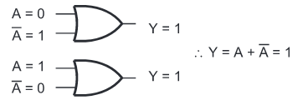

Slide 16
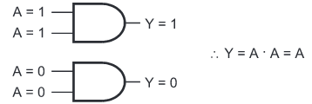
Illustration of Rule 7 Output, Y= A.A =A

Slide 17

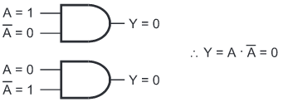

Slide 18

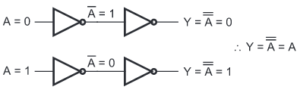
Illustration of Rule 9 Output,

Slide 19
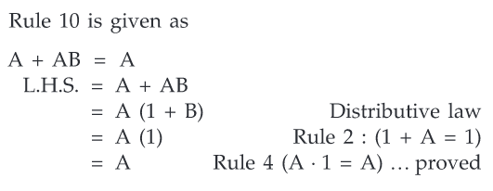
Proof of rule 10

Slide 20

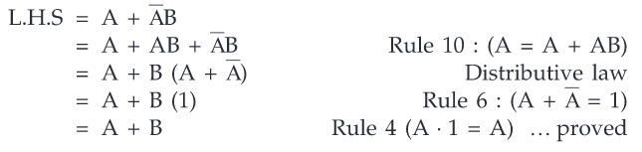
Proof of rule 11

Slide 21
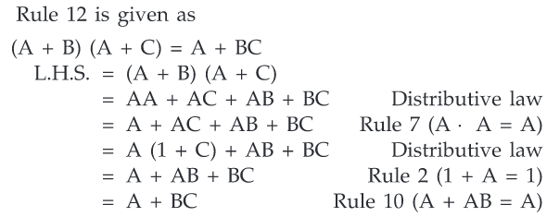
Proof of rule 12

Slide 22
Duality Theorem
The duality theorem states that, starting with a Boolean relation, you can derive another Boolean relation by :
Changing each OR sign to an AND sign
Changing each AND sign to an OR sign
Complementing any ‘0’ or ‘1’ appearing in the expression.
Duality theorem is useful because it sometimes produces a new Boolean relation.

Slide 23
Consider on example,
As per Distributive Law A(B+C) = AB + AC
By changing each OR and AND operation, we get the dual relation
A+ BC =(A+B) (A+C) +
+

Slide 24
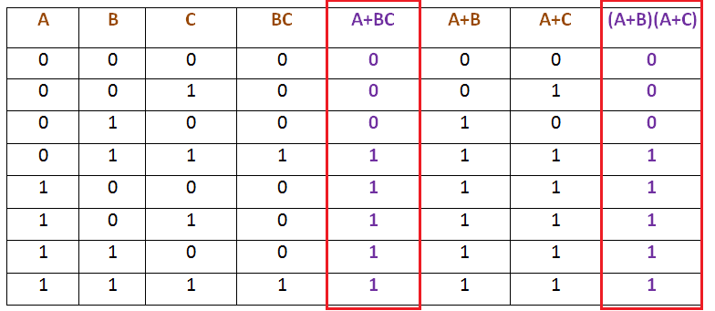

Slide 25

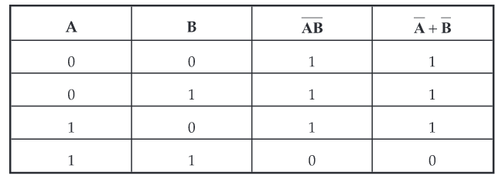
DeMorgan’s Theorem
DeMorgan suggested two theorems that form an important part of Boolean algebra.
1)
The complement of a product is equal to the sum of the complements.
Truth Table

Slide 26

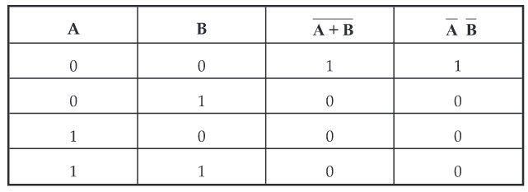
2)
The complement of a sum is equal to the product of the complements.
Truth Table

Slide 27
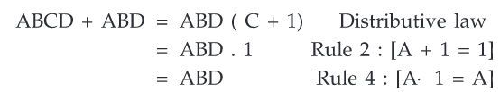
Reducing Boolean Expressions
Examples:
1) Show that ABCD + ABD = ABD
Solution:

Slide 28


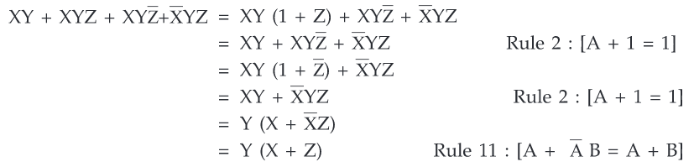
2) Show that AB+ABC+AB(D+E) = AB.
Solution
3) Show that

Slide 29

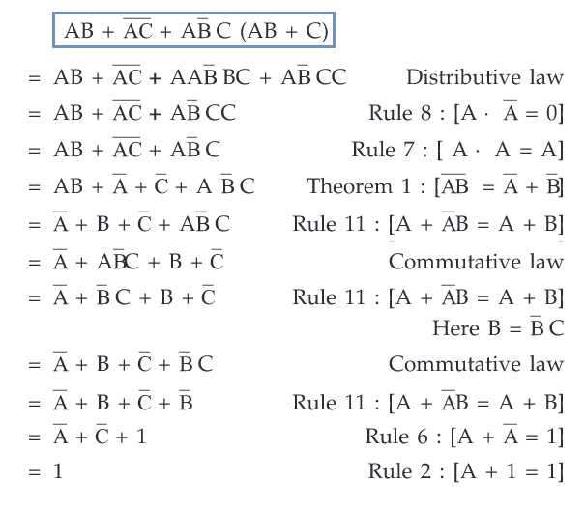
4) Show that
Solution:

